Slide 1
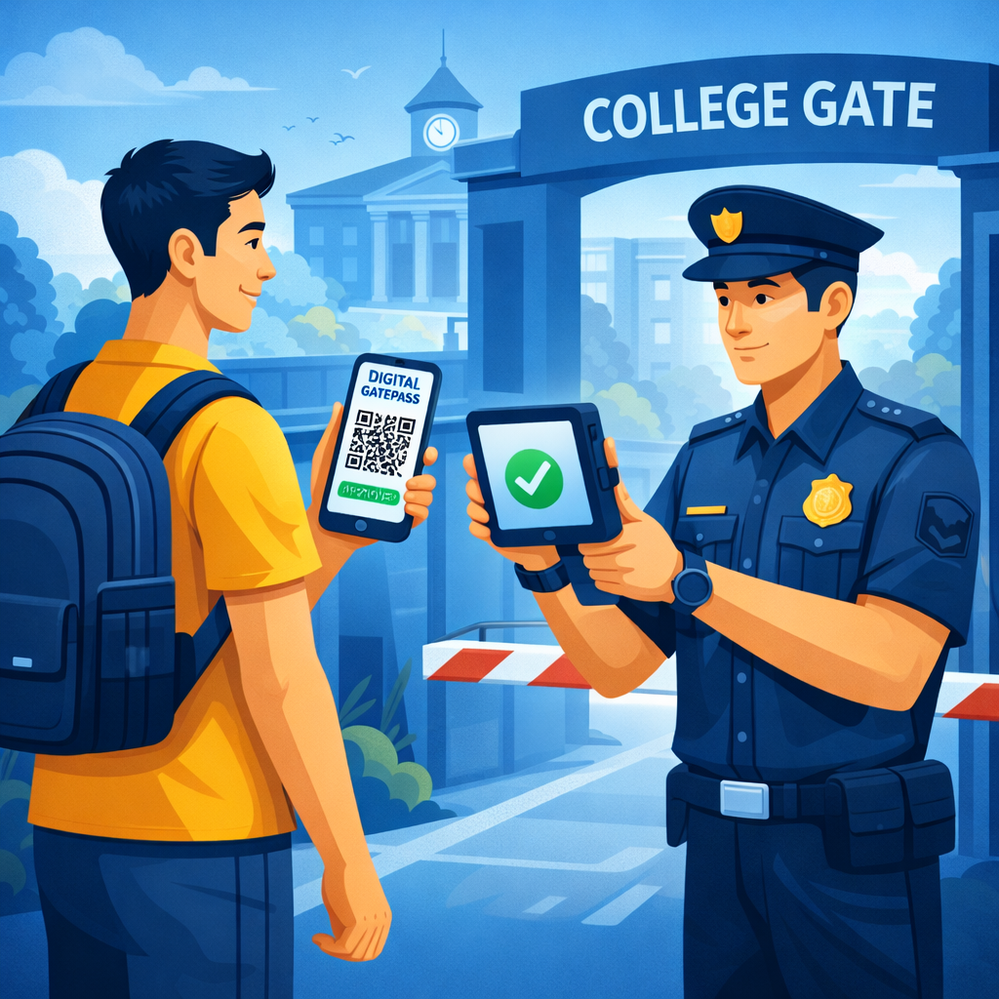
GATEPASS MONITORING SYSTEM
Guide: Team Members:
Divya S Nair
Meenu V S
Pavithra J J
Rahul B
Jithu S Sivan

Slide 2
Table of Content
Introduction
Literature Review
Second Review Objectives
Problem Statements
Proposed System Architecture
Tools and Technologies
Second Review Completion Status
How it Works
Use case Diagram
Sequence Diagram
Conclusion

Slide 3
Introduction
A Gate pass Monitoring System is a digital system used to manage and track student entry and exit from a college campus.
In many colleges, gate passes are issued manually, which can lead to errors, misuse, and difficulty in maintaining records.
This system automates the process of requesting, approving, and verifying gate passes.
Students can request a gate pass, and the concerned authority can approve or reject it through the system.
The system helps maintain proper records and allows security staff to verify approved gate passes easily.
Overall, it improves security, reduces paperwork, and makes the gate pass process faster and more efficient.

Slide 4
Literature Review
Many colleges use manual gate pass registers to record student entry and exit from the campus. In the manual system, security staff write student details in a register, which takes more time and effort.
Manual records may sometimes be lost, damaged, or written incorrectly, which makes tracking difficult. Researchers suggest using a digital or automated gate pass monitoring system to solve these problems.
The student can request gate pass manually and the advisor can approve or reject them by scanning the barcode of student ID.
After approval, a notification is sent to parent automatically and then the gate pass information is stored in a database for future reference.
Some systems use barcodes of student ID cards to verify the gate pass quickly at the college gate.
The security staff can scan the code or ID card to check whether the gate pass is valid or not.
Automated systems help colleges save time, reduce paperwork, improve security, and manage student movement effectively.

Slide 5
Second Review Objectives
Develop Advisor Approval Module
To implement a module where the advisor can review and approve or reject student gate pass requests.
To ensure that only valid requests are forwarded to the next level of approval.
Implement HOD Verification Module
To develop a module that allows the Head of Department (HOD) to verify and approve the advisor-approved gate pass requests.
To maintain departmental control and monitoring of student exits.
Develop Security Verification Module
To create a module for the security staff to verify approved gate passes at the college gate.To record entry and exit details of students for security purposes.
System Integration and Testing
To integrate all modules including Student, Advisor, HOD, and Security modules.
To test the complete workflow of the Gate Pass Monitoring System and evaluate system performance for final implementation.

Slide 6
Problem Statements
Many colleges use a manual gate pass system using paper or registers.
The manual system is time-consuming for both students and security staff.
Human errors can occur while writing or checking the details.
Gate pass records may be lost, damaged, or difficult to maintain.
It is hard for college authorities to track student entry and exit properly.
Manual gate passes can be misused or duplicated, which affects campus security.
There is no centralized digital record to store and manage student movement.
Therefore, a digital gate pass monitoring system is needed to improve security, accuracy, and efficiency.

Slide 7
Proposed System Architecture
1. Faculty / Advisor Module
Faculty reviews the student's gate pass request.
Approves or rejects the request based on validity.
2. HOD Module
Manages student accounts and system records.
Monitors all gate pass activities and maintains reports.
3. Database
Stores student details, gate pass requests, approvals, and logs.
Keeps records for security and future reference.
4. Security Module
Security staff verifies approved gate passes at the college gate.
Allows or denies exit based on system verification.
5.System Flow
Student Request Gate Pass Manually → Faculty Approval → Database Update → Security Verification

Slide 8
Tools and Technologies
1. Front-End Technologies
HTML – Used to create the structure of the web pages.
CSS ,BOOTSTRAP 5– Used to design and style the user interface.
2. Back-End Technologies
Django– Manage gate pass approval, and connect with the database.
3. Database
MySQL – Used to store student details, gate pass requests, approvals, and records.

Slide 9
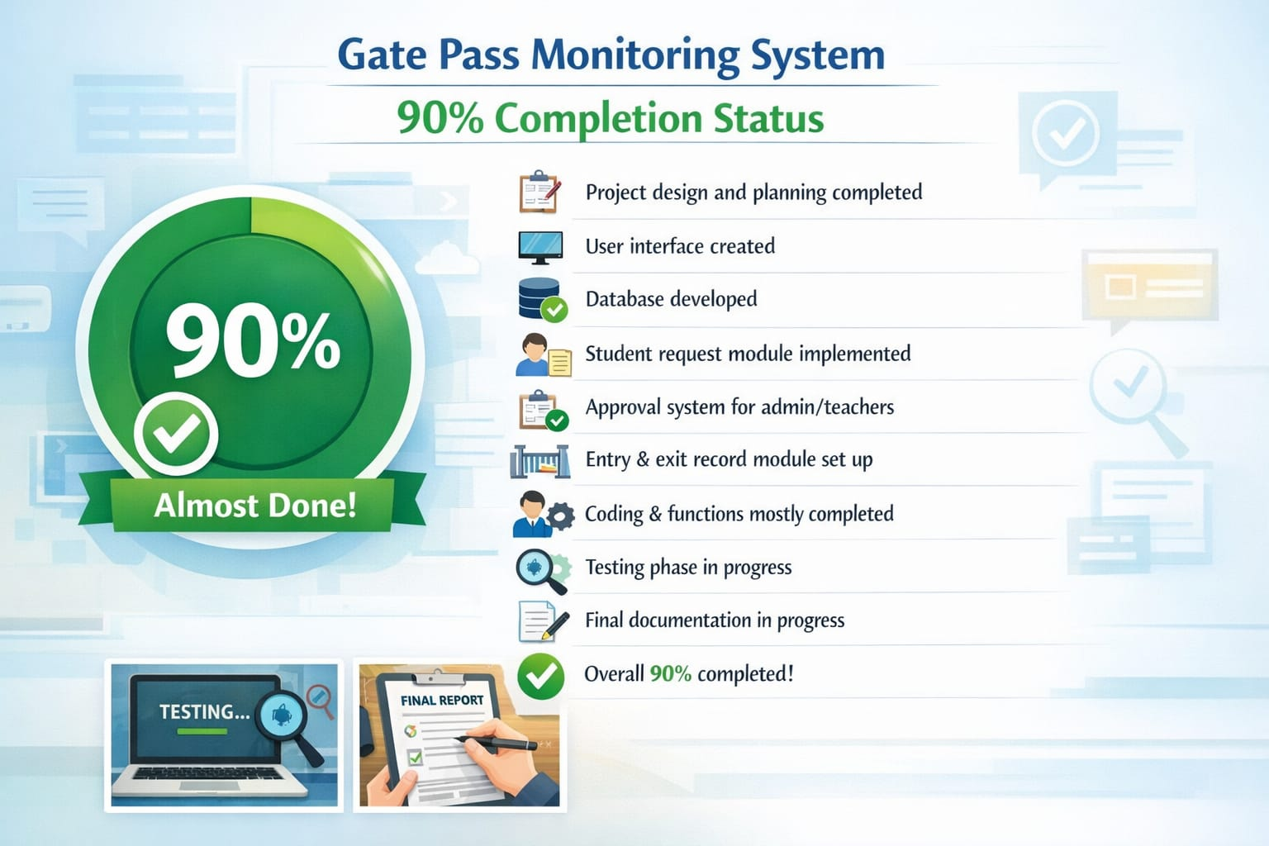
Second Review Completion Status

Slide 10
How it Works- Advisor Module
Login
The advisor logs into the system using their username and password.
View Gate Pass Requests
The advisor can see the list of gate pass requests submitted by students.
Check Request Details
The advisor reviews details such as student name, reason for leaving, date, and return time.
Approve or Reject Request
The advisor decides whether to approve or reject the gate pass request.
Status Update
Once approved, the request status is updated in the system and becomes visible to the security staff.
Record Maintenance
All approved and rejected requests are stored in the database for future reference.

Slide 11
How it Works- HOD Module
Login
The HOD logs into the system using secure login credentials.
View Approved Requests from Advisor
The HOD can see the gate pass requests that were already reviewed by the advisor.
Verify Student Details
The HOD checks student information such as name, department, reason for leaving, and time.
Final Approval or Rejection
The HOD gives the final approval or rejection for the gate pass.
Update Gate Pass Status Once approved, the gate pass becomes valid and can be verified by the security at the college gate.
Record Management
All requests and approvals are stored in the database for tracking and reporting.

Slide 12
How it Works- Security Module
Login
The security staff logs into the system using their credentials.
View Approved Gate Passes
The system displays the list of gate passes that are approved by the Advisor and HOD.
Verify Student Details
The security checks the student ID and verifies the gate pass details in the system.
Allow Exit or Entry
If the gate pass is valid, the student is allowed to leave or enter the campus.
Update Exit/Entry Status
The system records the time when the student exits or returns.-
Maintain Records
All gate movements are stored in the database for monitoring and reporting.

Slide 13
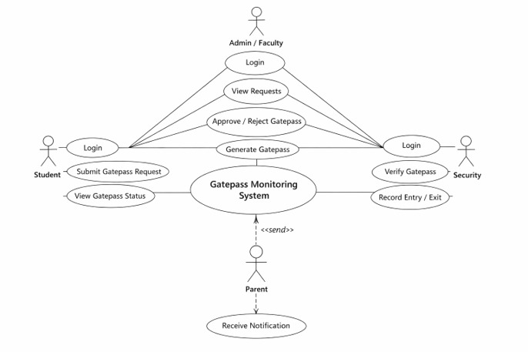
Usecase Diagram

Slide 14
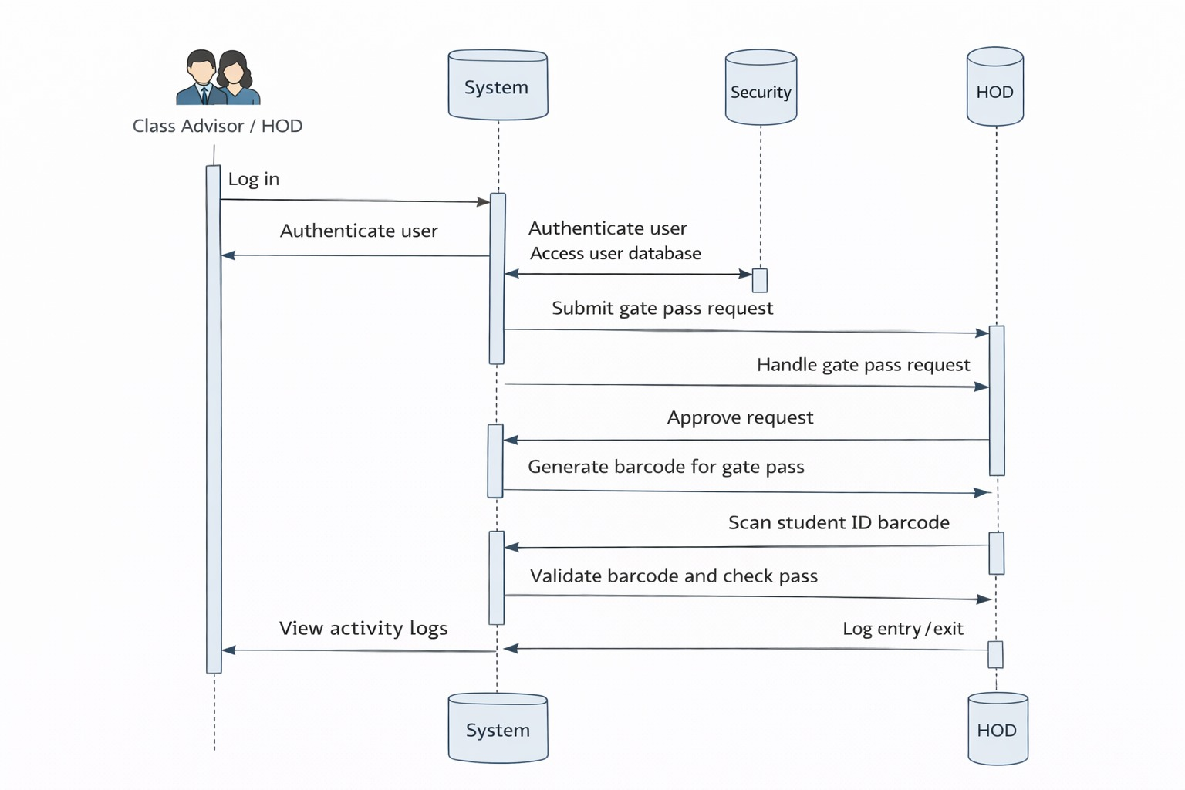
Sequence Diagram

Slide 15
Conclusion
The Gate Pass Monitoring System helps colleges manage the entry and exit of students in an organized way. The system replaces the manual gate pass method with a digital and automated process. It helps teachers or administrators approve the request easily.
This system reduces paperwork, saves time, and improves campus security. All student movement records are stored in a database, which makes it easy for the college to track and monitor them.
Overall, the Gate Pass Monitoring System is a simple and effective solution for managing student entry and exit in colleges. It helps improve safety, efficiency, and proper record management.

Slide 16
Thank You

